Slide 1



Slide 2
COOLING POWER OF MINE AIR
Personal comfort depends largely upon the rate of cooling of the human body.
The temperature, humidity, and velocity of the air should be within reasonable limits to permit the heat generated within the body to be removed at the same rate.
To judge whether a working place is suitable for a man to work efficiently and without discomfort, it is necessary to know
  the temperature of air at the working place,
  the relative humidity of air and
  air velocity.
Cooling power of air is the joint effect of above three factors.
Kata thermometer measures the air cooling power at the instrument temperature of 36.5 °C (normal temp. of human body).

Slide 3
The cooling power of mine air determines the capacity of the ambient atmosphere to dissipate the metabolic heat generated by the humans.
The cooling power measured in W/m² (amount of heat removes from the human body per second per unit surface area)
It depends mainly on the wet bulb temperature and the air velocity.
Kata thermometer
Kata thermometer is devised to simulate the human heat exchange process with the ambient atmosphere.
The kata cooling factor or kata factor is the amount of heat lost in millicalories by the air per cm2 of surface area of the bulb in cooling from 38 °C to 35 °C.
This factor divided the time required in seconds for the alcohol column to drop from the 38 °C mark on the stem to the 35 °C mark gives the cooling power.

Slide 4
Air cooling power (W/m²) = Kata factor/time in sec for alcohol to fall from upper mark to lower mark
The cooling power is called dry if no wet cloth is used on the bulb, and wet if wet cloth is used.
The dry-kata reading gives an estimate of the heat loss from the surface of the bulb due to radiation and convection.
Hence is of little importance, particularly under hot and humid conditions where most of the heat loss from the human body is through evaporation of sweat.
In order to simulate a sweat-covered body, the kata thermometer bulb is encased in wet muslin to take the wet-kata reading.
The idea is to make it resemble the human body which loses heat by radiation, convection as well as evaporation.

Slide 5
The wet-kata cooling power is related to the wet-bulb temperature and the air velocity by the following relations.
K = (14.65 + 35.59 v^{1/3}) (309.65 – T’) for air velocities < 1 m/s
K = (4.19 + 46.05 v^{1/3}) (309.65 – T’) for air velocities >1 m/s
Where
K = kata cooling power of air or the heat loss in W/m2
v = velocity of air in m/s
T’ = wet-bulb temperature in K
By knowing the wet kata cooling power one can compute air velocity, and vice versa using the equations.

Slide 6
Limitations of kata cooling power
Since kata thermometers have a smaller volume to surface area ratio compared to the human body the analogy between the kata thermometer and a person is not very good. Kata thermometer only gives a better indication of air cooling power.
The kata factor varies with temperature for which kata cooling power is not always constant. 10% variation in kata factor occurs if the air temperature changes from 283 to 303 K.
In an unventilated or poorly ventilated area, the moisture evaporated surrounds the wet-bulb and hence the thermometer gives a higher reading of wet-bulb temperature than the true value.
Therefore, kata thermometer overestimates the effect of air velocity and underestimates that of temperature and humidity as regards the cooling power.
The instrument is not popular because of the fragility of the large bulb and the necessity of carrying hot water in a thermos flask for use underground.

Slide 7
METHODS OF IMPROVING COOLING POWER OF MINE AIR
By increasing the quantity of ventilating air.
By circulating drier air
By cooling or refrigeration of the circulating air
By regenerative cooling
Using devaporized compressed air
Cooling of mine air at the face by using ice or liquid air

Slide 8
By increasing quantity of air
This should be the first option to be tried for improving hot and humid conditions in mines.
The increased quantity of air not only dilutes the heat produced in the mine but also produces a higher air velocity which improves the cooling power of mine air.
In deep mines some extra quantity of air is necessary for suitably dealing with the heat produced in the mine from variety of sources.
In addition, an estimate of heat addition in a mine from different sources should be made and the air quantity requirement for dilution of this heat evaluated for improving the cooling power of mine air.

Slide 9
If q is the amount of heat added in any part of the mine per unit time (kW), then for heat balance
M Ha = q + M Hi
Or , Q = q/(Ha - Hi)ρ
Where
M = mass flow-rate of dry air, kg/s = Q ρ
Q = quantity of air flowing, m3/s
ρ = apparent density, (kg of dry air per m³ of moist air)
Ha = allowable enthalpy of air, kJ/kg of dry air
Hi = enthalpy of in-flowing air, kJ/kg of dry air.

Slide 10
At one mine on the Witwaterstrand Gold Field the quantity of air was increased from 40.6 m3/s to 135 m3/s and a refrigeration plant was installed simultaneously to improve the conditions of temperature and humidity in the mine.
The total heat extracted by the increased quantity of air was 3.39 MW, nearly twice as much as extracted by the refrigeration plant alone (1.55 MW).
The wet-kata cooling power improved from 289 to 523 W/m2 with a 30% increase in the production efficiency.
There was a reduction in the cases of heat stroke by two-third and a considerable reduction in the rates of accident and sickness.

Slide 11
Limitations of increasing air volume
Mine airways should be large enough to take the extra quantity of air without causing excessive frictional pressure loss and excessive air velocity.
High pressure loss increases the power cost of ventilation.
High velocity raises dust in the roadways.

Slide 12
By drying of mine air
In deep and hot mines where air temperature is high, maintaining the air dry helps in improving the working conditions.
There is no economical process of drying the air as such except refrigeration.
Drying of mine air by passing it over desiccants like calcium chloride, magnesium chloride or silica gel is costly.
Also the advantages gained by drying is greatly compensated by the heat produced by absorption which raises the air temperature.
It is better to take adequate care to see that the air does not pick up moisture in the mine and hence is maintained dry.
This is done by adopting dry mining by preventing the evaporation of water oozing out from the strata.

Slide 13
Measures to be taken :
Adopting dry dust-collecting means rather than using water for dust suppression in very hot mines.
By spraying of fuel oil over the surface of airways considerably reduces evaporation from surface.
By providing concrete lining in the major airways.
Providing suitable drain pipes in the roadways to drain off the water from behind the lining and thus preventing moisture evaporating into the mine air.
Covering up of water drains is a long term solution in minimizing evaporation of moisture into the mine air.

Slide 14
By refrigeration of circulating air
Refrigeration of mine air is necessary when its temp. becomes excessive so that no futher increase in the quantity of air would improve environmental conditions.
Air is cooled and dehumidified by the refrigeration plants so that it is saturated at 275 to 278 K.
It is then conducted to the working faces as such or mixing with a stream of uncooled air so as to obtained the desired face temps.
Hence a refrigeration plant should be designed to have a capacity sufficient for cooling the farthest face.

Slide 15
Calculation of cooling load of a refrigerator
If total heat added to the mine air from different sources = q, kW
The required cooling load (q_{c}) is given by the heat balance equation
q_{c} = q + Q ρ (Hi - Ha), kW
Where
Q = quantity of air flowing, m3/s
ρ = apparent air density, (kg of dry air per m³ of moist air)
Ha = allowable enthalpy of air, kJ/kg of dry air
Hi = enthalpy of in-flowing air, kJ/kg of dry air.
Cooling load should be calculated for the maximum heat content of the in-flowing air which occur in summer

Slide 16
By regenerative cooling
This concept is only theoretical and yet to be adopted in practice.
If a gas of high density and low specific heat like CO2 circulated in a close circuit down the upcast shaft and up again through the downcast shaft, the heat developed due to auto-compression of CO2 will be dissipated into the upcast air while the cooling due to auto expansion will cool the downcast air.
This not only produce cooling of the downcast air but also increase the natural ventilation.

Slide 17
By circulating devaporized compressed air
Devaporization is done by over compressing the air by 500-650 kPa.
It is then passed through a heat exchange system where the over compressed air is cooled by a current of cool devaporised compressed air.
The cooled over compressed air is now employed to run an air motor. In doing so it expands to the normal working pressure and also cools to 273 K.
At this temperature all the moisture in compressed air is liquefied and removed from it.
The dry and cool compressed air is now circulated through heat exchanger to cool the over compressed air.
The devaporized air is now sent down the mine where it is used to run air motors, drills etc. at the face.
The exhaust air from these machines gets substantially cooled by expansion.
This coupled with dryness of the air helps in keeping down the temperature and humidity at the face.

Slide 18
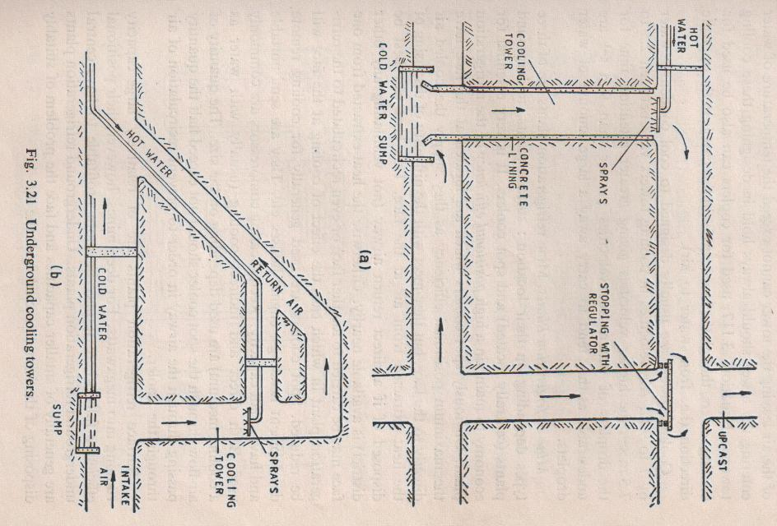

Slide 19
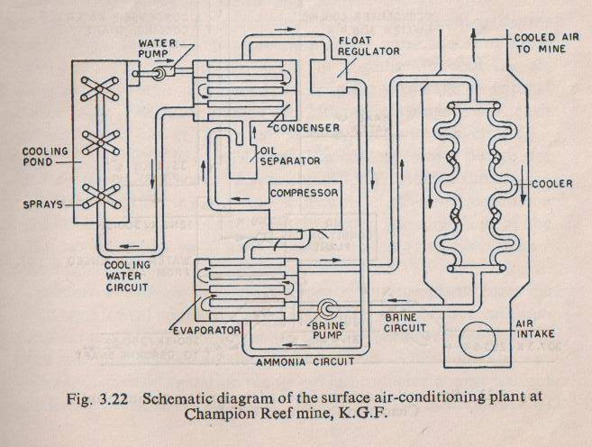

Slide 20
